Slide 1
PADDY DISEASE DETECTION
SL.NO | NAME | ROLL NUMBER
1 | Darneshwar S | CB.EN.U4CSE21309
2 | S Keerthana | CB.EN.U4CSE21349
3 | Preethi V | CB.EN.U4CSE21365
Subject code : 19CSE437
Subject Name : Deep Learning for Computer vision
Review-3

Slide 2
Agenda
Overall Architecture Diagram
Existing Product features
Module Diagram
Explanation of Modules
Technology Stack
UI wireframe designs --- For each module
Working of the product

Slide 3
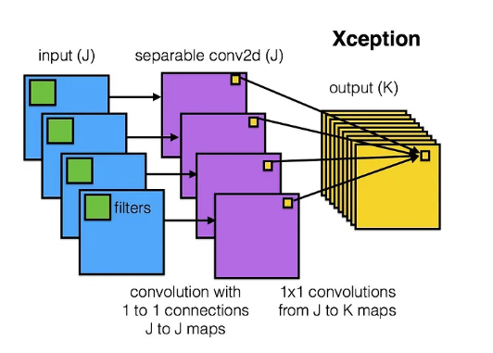
Resnet Architecture
CSE21309

Slide 4
Existing Product Features
Image Upload Module:
Feature: Allows users to upload an image for classification.
Implementation: The st.file_uploader function is used to enable file uploads. Once the image is uploaded, it is displayed on the interface using st.image.
Model Loading Module:
Feature: Loads the pre-trained Xception model for image classification
.
Implementation: The model is loaded using the load_model function from TensorFlow, which retrieves the model saved in a .h5 format. It ensures efficient reuse of the model through st.cache to avoid reloading on every interaction.

Slide 5
Image Preprocessing Module:
Feature: Prepares the uploaded image for input into the Xception model.
Implementation: The image is resized to the Xception model's required input size (299x299), normalized, and expanded to match the model’s input dimensions.
Prediction Module:
Feature: Performs the classification by passing the preprocessed image through the Xception model.
Implementation: The image is fed into the Xception model using model.predict(). The prediction result is a probability distribution across classes, which is processed to return the highest confidence class.

Slide 6
Result Display Module:
Feature: Displays the classification result (disease name or object class) and the associated confidence score.
Implementation: TResult Display Module:he classification result is formatted and displayed using st.write, showing the predicted class and the confidence value.
Image and Accuracy Display Module:
Feature: Displays the uploaded image along with the model's prediction and confidence.
Implementation: After prediction, both the uploaded image and the prediction result are shown side by side. The image is rendered using st.image, and the accuracy (confidence score) is displayed below it.

Slide 7
Model Accuracy Display Module:
Feature: Shows the overall model accuracy based on its performance on the test set.
Implementation: After prediction, a pre-calculated accuracy metric (saved during training) is displayed alongside the image and classification result using st.write.

Slide 8
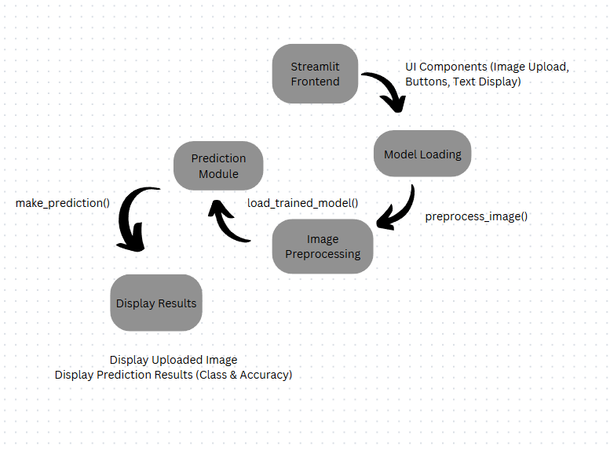
Module Diagram

Slide 9
Streamlit Frontend
Purpose: This is the user interface layer where the user interacts with the application. It handles how users upload images, trigger actions, and view the results.
Components:
Image Upload: Provides an interface for users to upload an image that will be used for classification.
Buttons: The interface includes a button that users can click to start the prediction process (e.g., "Predict").
Text Display: Displays information like instructions, prediction results, and accuracy scores. This module ensures that users can see the output of their actions in a readable format.
Image Preprocessing
Purpose: This module prepares the uploaded image so that it can be correctly analyzed by the Xception model. The preprocessing steps ensure that the image matches the input requirements of the model.
Process:
Resizing: Adjusts the size of the uploaded image to the input size expected by the Xception model.
Normalization: Scales pixel values to a range suitable for the model’s input, ensuring consistency across different images.
Channel Adjustment: If necessary, adjusts the image format (e.g., converting grayscale to RGB) to match the model’s requirements.

Slide 10
Model Loading
Purpose: This module is responsible for loading the pre-trained Xception model into memory so that it can be used for making predictions.
Process:
The pre-trained model is loaded from storage and remains in memory while the app is running, so it doesn’t need to be reloaded with every prediction.
This module optimizes the app’s performance by caching the model, ensuring faster predictions.
Prediction Module
Purpose: This module is where the actual classification takes place. It uses the preprocessed image to make a prediction based on the Xception model.
Process:
The preprocessed image is passed to the loaded model, which then performs the classification.
The model outputs a set of probabilities corresponding to different classes. The class with the highest probability is considered the predicted class.

Slide 11
Display Results
Components:
Display Uploaded Image: This component displays the image uploaded by the user so they can visually confirm which image is being classified.
Display Prediction Results (Class & Accuracy): This component shows the predicted class and its associated confidence score. The result is displayed in an easy-to-read format, giving feedback to the user on the model’s prediction accuracy.

Slide 12
Technology Stack
Frontend: Streamlit
Streamlit is a Python framework used to build interactive web applications. It allows you to easily create user interfaces (like image upload buttons and result displays) without needing extensive frontend coding (like HTML, CSS, or JavaScript).
It’s simple and effective for building data-driven apps and displaying real-time results to users. Streamlit handles the user interface and makes the app interactive by allowing users to upload images, trigger predictions, and see results.
Backend: Python & TensorFlow
The core of your app runs on Python, where you use the TensorFlow framework to load the Xception model, preprocess the images, and make predictions.
Python is widely used in machine learning and data science because of its simplicity and rich ecosystem of libraries. TensorFlow is a powerful tool for working with machine learning models, and the Xception model is a deep learning architecture that's particularly effective for image classification.

Slide 13
Machine Learning Model: Xception
Xception is a pre-trained neural network model specialized for image classification tasks. When a user uploads an image, this model analyzes it and makes predictions about which class (category) the image belongs to.
Pre-trained models like Xception are efficient because they’re already trained on large datasets (e.g., ImageNet), which means you can use them directly or fine-tune them for your specific task without having to build a model from scratch.
Image Processing: PIL and NumPy
Before passing the uploaded image to the model, it needs to be resized and normalized. The Pillow (PIL) library helps with image processing, such as resizing and format conversion. NumPy is used to handle the image data in the form of arrays and perform mathematical operations, such as normalization.
PIL and NumPy are widely used libraries for image manipulation and efficient handling of large datasets in machine learning workflows.

Slide 14
Environment Management: Virtual Environments
You use virtual environments (like myenv and the training environment) to keep your project’s dependencies (like TensorFlow) separate and ensure compatibility between different versions of software.
Managing environments helps avoid conflicts between different package versions (e.g., TensorFlow 2.15.0 in one environment vs. 2.17.0 in another), making sure your app runs smoothly without version-related issues.

Slide 15
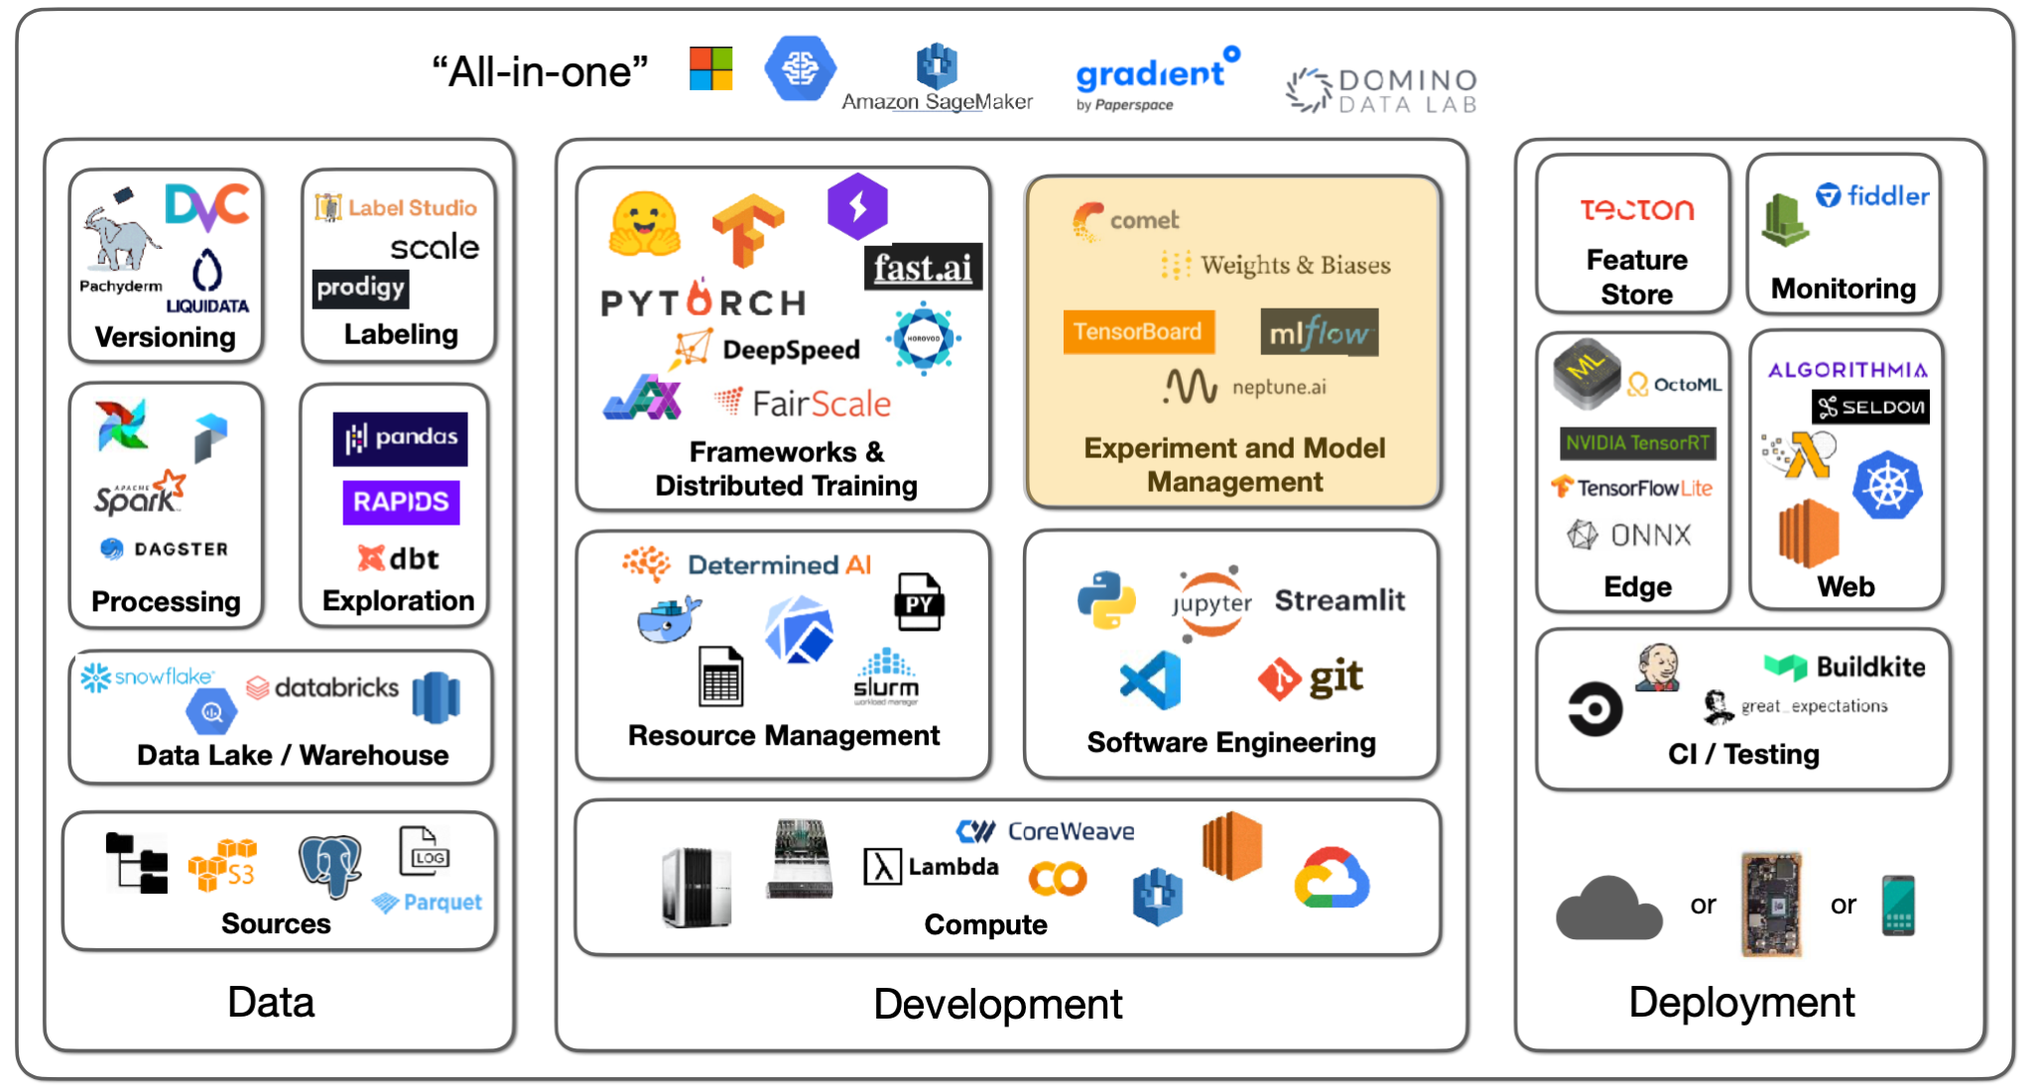

Slide 16
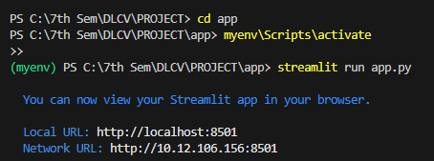
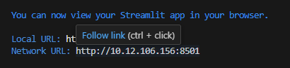
Wireframe Designs
First, The Web-app is installed in a virtual environment that has been within in a file.
Then using the command streamlit run app.py, the following streamlit code opens the web browser
You can see that, the streamlit app provides the Local URL for the webpage to be opened

Slide 17
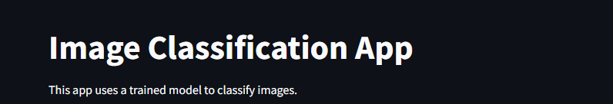
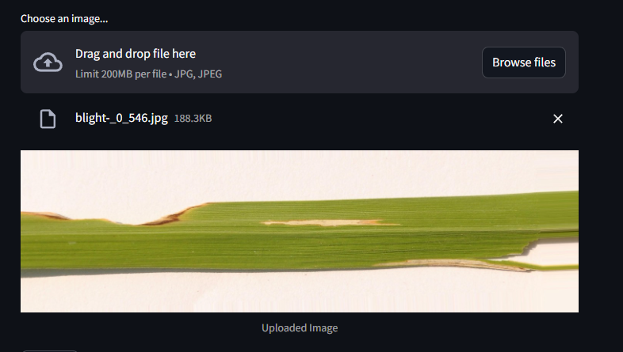
The Final Output!
This is the First part of the output where the UI is displayed, Which asks for the image as the Input. So once the image is given an input, the following will display the output

Slide 18
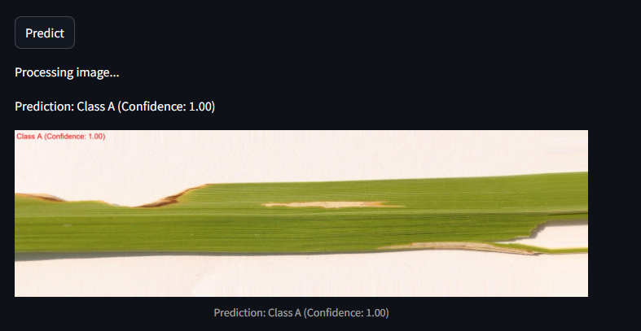
This is the Second part of the output, where you can see that predict button is given.
Once you click the button, the following input image is driven into the model and the classification happens.
I have designed the code to classify based on classes of images. So class A is called Bacterial Leaf Blight.

Slide 19
UI Wireframe Designs
Module | Wireframe design Name | Student Associated(RollNo,Name)
image uploads and displaying results | UserInterface | Darneshwar S (CB.EN.U4CSE21309)
Preprocesses images for analysis | ImageProcessing | Darneshwar S(CB.EN.U4CSE21309)
Implements deep learning models to classify paddy diseases. | DiseaseClassification | Darneshwar S (CB.EN.U4CSE21309)
Manages user data, uploaded images, and logs of disease detection results. | Database management | Darneshwar S(CB.EN.U4CSE21309)

Slide 20
Working of the product
User Interface Initialization:
When the user accesses the app, the Streamlit interface is initialized. This includes the title and any introductory text that describes the purpose of the application.
Image Upload:
Feature: Users can upload an image of paddy plants to classify potential diseases.
Implementation: The st.file_uploader function creates a file upload button on the interface. Users can select an image file (e.g., JPG or PNG) from their local machine. Once uploaded, the app uses st.image to display the image on the screen.

Slide 21
Model Loading:
Feature: The app loads the pre-trained Xception model, which has been trained on a dataset of paddy diseases.
Implementation: The model is loaded using load_model from TensorFlow. To enhance performance and minimize loading time, the model loading process is cached with st.cache, ensuring the model is loaded only once during the app session.
Image Preprocessing:
Feature: The uploaded image needs to be preprocessed to match the input requirements of the Xception model.
Implementation: The uploaded image is resized to the model's input size (299x299 pixels). It is then normalized (typically scaled to a range of 0 to 1) and expanded in dimensions to fit the expected input shape for the model (usually a batch size is added). This is essential for the model to interpret the input correctly.

Slide 22
Prediction:
Feature: The preprocessed image is classified using the Xception model.
Implementation: The app calls model.predict() on the preprocessed image. The model returns a probability distribution across the different disease classes. The app then processes this output to determine the class with the highest confidence score, identifying the predicted disease.
Result Display:
Feature: The classification result is presented to the user.
Implementation: The app formats and displays the prediction result using st.write, showing the predicted disease name (or object class) along with the associated confidence score

Slide 23
Image and Confidence Display:
Feature: The uploaded image is shown alongside the prediction result and confidence score.
Implementation: The app renders the uploaded image again using st.image, and the prediction result, including the confidence score, is displayed directly below the image. This provides a clear and concise view of the output.
Model Accuracy Display:
Feature: The overall accuracy of the model based on its training and validation performance is presented.
Implementation: The app displays a pre-calculated accuracy metric using st.write.
CSE21309

Slide 24
Agenda
Overall Architecture Diagram
Existing Product features
Module Diagram
Explanation of Modules
Technology Stack
UI wireframe designs --- For each module
Working of the product

Slide 25
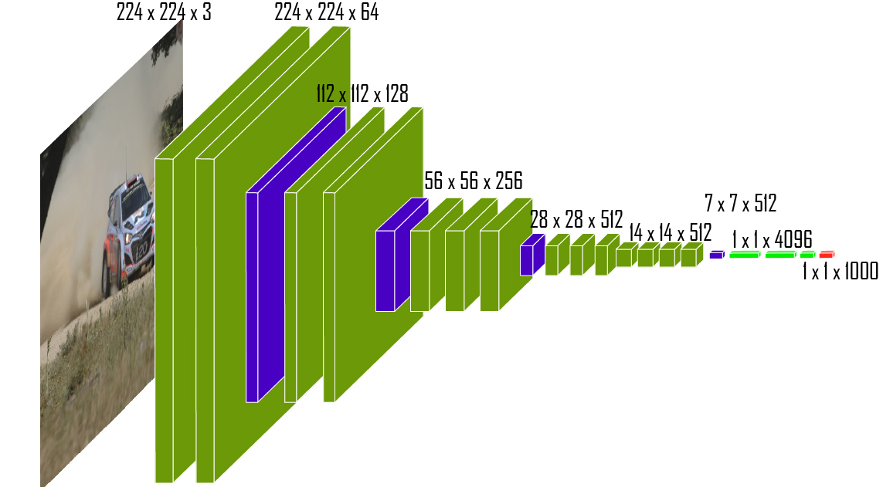
VGG Architecture Diagram

Slide 26
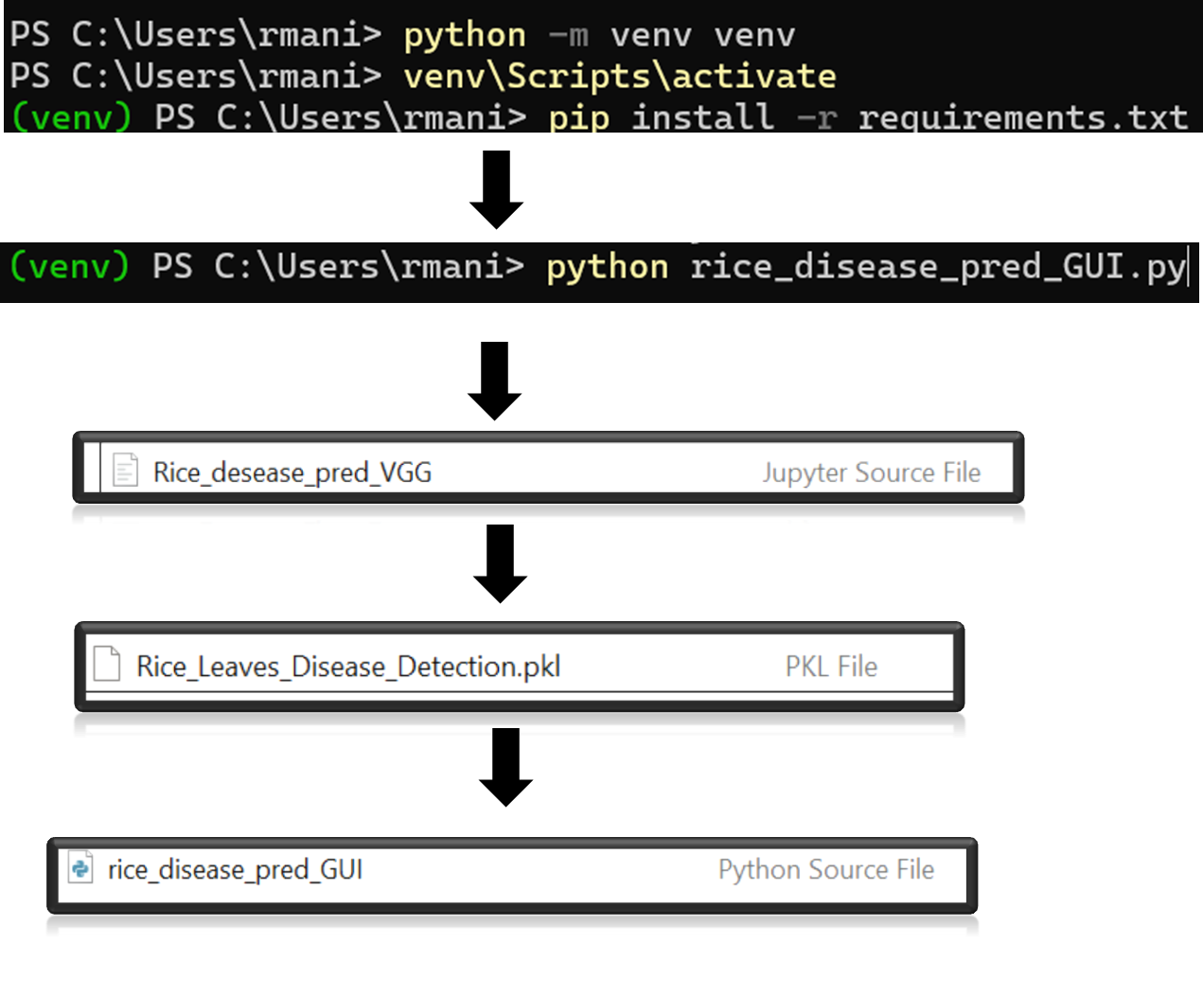
Environment setup for FLASK
Image source : Keerthana_VGG_poster.pptx

Slide 27
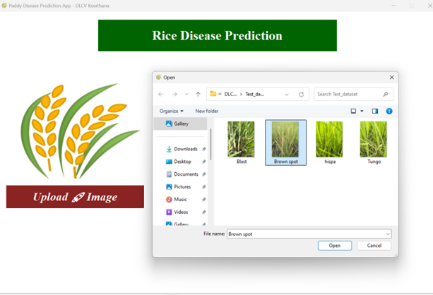
Input : Upload the image from local computer
Image source : Keerthana_VGG_poster.pptx

Slide 28
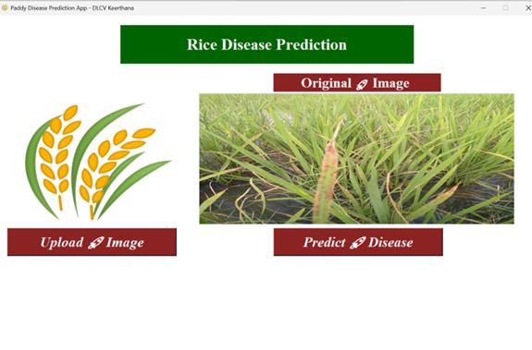
Model processing in Background
Image source : Keerthana_VGG_poster.pptx

Slide 29
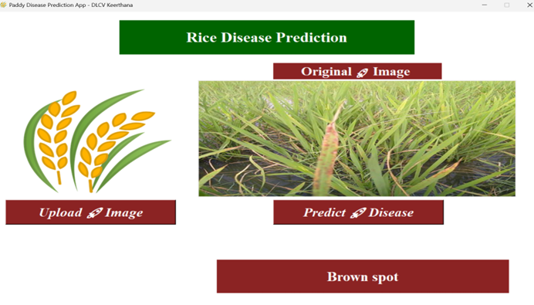
Final Prediction
Image source : Keerthana_VGG_poster.pptx​

Slide 30
Module Diagram -
Contribution : Keerthana CB.EN.U4CSE21349
User Interface Module
Disease Detection Module
Image Upload Module
PADDY DISEASE CLASSIFICATION APP
Database Management Module
Image Preprocessing Module
Evaluation module

Slide 31
Explanation of Modules
Contribution : Keerthana CB.EN.U4CSE21349​
1. Image Upload and Displaying Results
Users can easily upload images of paddy leaves.
Uploaded images are displayed immediately for user confirmation.
Supports multiple image formats (e.g., JPG, PNG).
2. Image Preprocessing for Analysis
Images are resized and normalized to fit model requirements.
Data augmentation techniques may be applied to enhance model robustness.
Ensures high-quality input for accurate disease classification.
3. Deep Learning Model Implementation
Utilizes pre-trained models (e.g., CNNs) for disease classification.
Models are trained on a diverse dataset of paddy diseases.
Outputs include detected diseases with confidence scores.
4. Result Presentation
Displays detected diseases along with descriptions and treatment recommendations.
Provides a user-friendly interface for easy navigation and understanding.
Option for users to provide feedback on prediction accuracy.

Slide 32
Technology Stack of the product
Contribution : Keerthana CB.EN.U4CSE21349​
1. Backend Framework
Flask
2. Machine Learning Libraries
TensorFlow
Keras
3. Image Processing Libraries
OpenCV
Pillow
4. Database Management​
SQLite​
SQLAlchemy​
5. Frontend Technologies​
HTML​
CSS​
JavaScript​

Slide 33
UI wireframe designs
Module | Wireframe design Name | Student Associated(RollNo,Name)
image uploads and displaying results | UserInterface | S Keerthana (CB.EN.U4CSE21349)
Preprocesses images for analysis | ImageProcessing | S Keerthana (CB.EN.U4CSE21349)
Implements deep learning models to classify paddy diseases. | DiseaseClassification | S Keerthana (CB.EN.U4CSE21349)
Manages user data, uploaded images, and logs of disease detection results. | Database management | S Keerthana (CB.EN.U4CSE21349)

Slide 34
Wireframe Designs for Paddy Disease Classification App
The following wireframe designs illustrate the user journey from input to output within the Paddy Disease Classification application. Each design represents a key interaction point, showcasing how users will engage with the app.
1. Home Screen
Components:
Navigation Bar: Links to Home, Disease Detection
Quick Access Buttons:"Detect Disease"
2. Disease Detection Screen
Components:
Image Upload Section:
Button to upload an image of paddy leaves.
Option to take a photo directly using the camera.
Submit Button: To send the image for analysis.

Slide 35
3. Processing Screen
Components:
Loading Animation: Indicates that the image is being processed.
Message Display: "Analyzing your image, please wait..."
Processing Screen Wireframe
4. Results Display Screen
Components:
Detected Diseases Section:
List of diseases detected with images
5 Interaction Flow
Uploads Image: The user uploads an image of paddy leaves or takes a new photo.
Processes Image : After submission, the processing screen appears, indicating that the image is being analyzed.
Receives Results: Once processing is complete, the results display screen shows detected diseases and recommendations.

Slide 36
Working of the product
Contribution : Keerthana CB.EN.U4CSE21349​
1. User Accesses the Application
The user opens the web application in their browser, which is served by the Flask backend.
2. Image Upload
The user navigates to the Disease Detection section.
They see an interface with an option to upload an image of paddy leaves.
The user clicks on the Upload Image button and selects an image from their device.
3. Image Submission
Upon selecting the image, the user clicks on the Submit(PREDICT) button.
The application captures this action and sends a POST request to the Flask server with the uploaded image.

Slide 37
4. Image Processing
The Flask backend receives the image and passes it to the Image Processing Module.
This module preprocesses the image (e.g., resizing, normalization) to prepare it for analysis.
5. Disease Prediction
The preprocessed image is then forwarded to the Disease Detection Module.
Here, machine learning or deep learning models (e.g., TensorFlow/Keras) analyze the image to classify any diseases present.
The model outputs predictions along with confidence scores for each detected disease.
6. Results Display
The Flask backend formats the prediction results into a JSON response.
Response : Detected diseases
The application sends this response back to the user interface.

Slide 38
Agenda
CSE21365
Overall Architecture Diagram
Existing Product features
Module Diagram
Explanation of Modules
Technology Stack
UI wireframe designs --- For each module
Working of the product

Slide 39
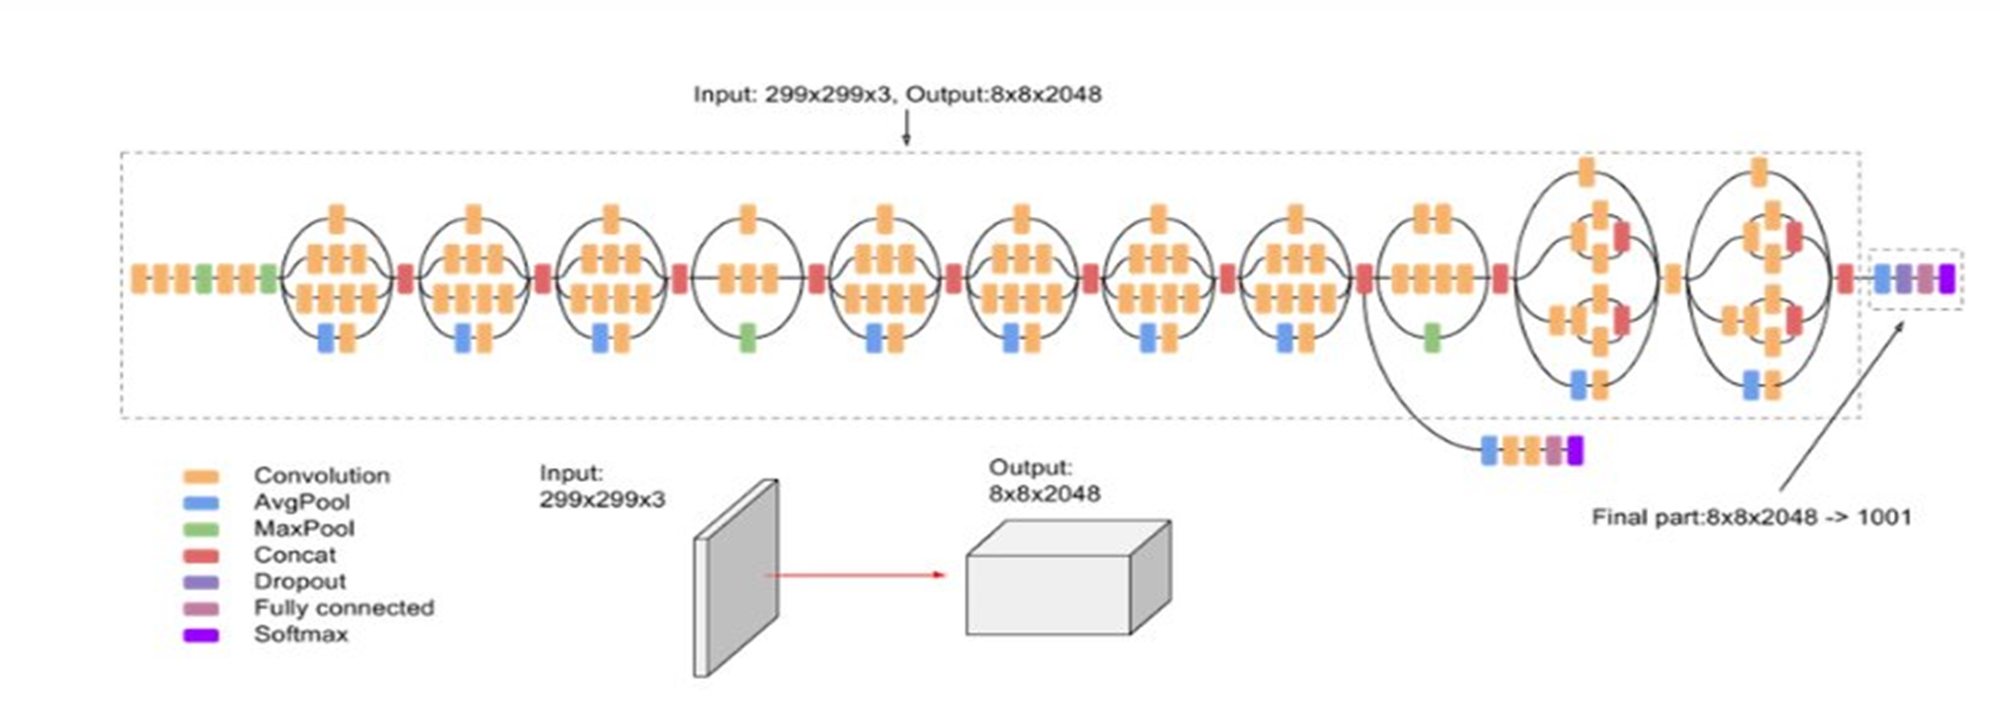
Inception Architecture Diagram
CSE21365

Slide 40
Existing product features
CSE21365
Image Upload Module:
Feature: Users can upload paddy leaf images using a simple form with file input support for image types (e.g., JPG, PNG). The module also handles basic validation to ensure the correct file format is uploaded.
Implementation: The module uses HTML’s <input type="file"> element and is styled for user-friendly interaction. It includes JavaScript to handle the file selection.
Image Preview Module:
Feature: After uploading, the selected image is immediately previewed on the screen, allowing users to verify the image before submission.
Implementation: A FileReader object is used in JavaScript to render the image for preview in an <img> element, displaying the image directly within the interface without submitting the form.
Disease Detection Module:
Feature: Once the image is uploaded, the system simulates disease detection by randomly selecting a predefined disease (such as Bacterial Leaf Blight, Brown Spot, etc.) and displays an accuracy score for the result.
Implementation: The detection is simulated using an array of possible diseases in JavaScript. Upon submission, the system randomly selects a disease and corresponding accuracy score to display to the user.

Slide 41
Result Display Module:
Feature: The detection result, including the disease name and accuracy score, is presented in a clearly visible section on the page after the detection process is complete.
Implementation: The result is dynamically inserted into HTML elements using JavaScript and is displayed once the detection simulation completes. The result container is hidden by default and is only shown after submission.
Suggested Action Module:
Feature: Based on the detected disease, the system provides relevant suggested actions for disease management, such as pesticide recommendations or preventive measures.
Implementation: Similar to the detection result, the suggested actions are predefined and displayed to the user after the disease detection process. Each disease has corresponding suggestions stored in an array or object in JavaScript.
User Feedback Module:
Feature: Users can give feedback on the detection result and suggested action. They can rate the accuracy of the detection or leave comments on whether the suggested actions were helpful. This feedback can help improve the system's accuracy.
Implementation: A form with input fields (e.g., star ratings, text comments) is displayed after the result and action suggestions are shown. Feedback is stored and can be processed for system improvement.

Slide 42
Module Diagram
CSE21365
Image upload module
Image preview module
Disease detection and result
Suggestion action
User feedback

Slide 43
Explanation of Modules
CSE21365
•Module 1: Image Upload
•A section to upload images, with a button labeled "Upload and Diagnose."
•Allows users to select an image and submit it for disease diagnosis.
•Module 2: Image Preview
•Displays the image preview after image diagnosis, including:
•Disease Name
Module 3: Result
•Confidence Score
Module 4: Suggested action
•Suggested Action for treatment
•Module 5: User Feedback
•A feedback form for users to provide their input after receiving the diagnosis.
•Contains a textarea and a "Submit Feedback" button.

Slide 44
Technology Stack of the product
CSE21365
Image Upload Module:
Frontend:
HTML5 for the form structure.
CSS for styling and user-friendly layout.
JavaScript for handling file input and event management.
Backend:
Flask or Django (Python frameworks) to handle image uploads.
Cloud Storage: AWS S3, Google Cloud Storage, or Azure Blob Storage for storing the uploaded images.
Image Preview Module:
Frontend:
JavaScript with FileReader API to preview the uploaded image before submission.
CSS for styling the image display area.
Backend: No backend required specifically for this part as it's handled on the client-side.

Slide 45
Disease Detection Module:
Backend:
Python for developing the disease detection logic.
OpenCV or TensorFlow/Keras for computer vision-based image analysis and deep learning.
Pre-trained Models or custom-trained models for detecting specific diseases.
REST API (Flask/Django) to handle the image submission and return disease detection results.
Database: A database like MongoDB or PostgreSQL to store disease types and results.
Result Display Module:
Frontend:
JavaScript or React.js for dynamically displaying detection results (disease and accuracy).
Backend:
The disease detection result fetched via API and displayed to the user.

Slide 46
Suggested Action Module:
Backend:
Python backend with a predefined list of disease-specific suggestions stored in a database (PostgreSQL, MongoDB).
API to fetch disease-specific recommended actions and display them to the user.
Frontend:
JavaScript or React.js to display the suggestions alongside the detection result.
CSS for formatting the suggestions section.
User Feedback Module:
Frontend:
HTML/CSS for the feedback form (ratings and comments).
JavaScript to capture and submit feedback.
Backend:
Flask/Django to handle feedback submission and store the feedback in a database.
Database: Use MySQL or MongoDB to store user feedback for further analysis.
Analytics Tools: Use tools like Google Analytics or custom Python scripts for analyzing feedback trends and improving the detection algorithm.

Slide 47
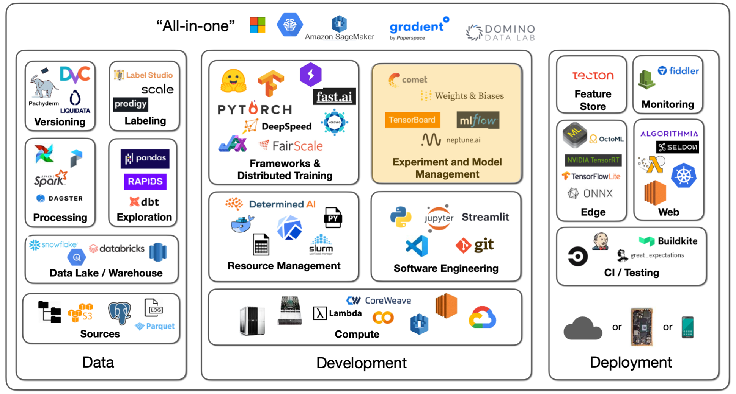

Slide 48
UI wireframe designs
Module | Wireframe design Name | Student Associated(RollNo,Name)
Image Upload | Image upload interface | CB.EN.U4CSE21365
Image Preview | Image confirmation preview | CB.EN.U4CSE21365
Disease Detection and Result | Disease detection process Detection results Display | CB.EN.U4CSE21365
Suggested action | Additional information & recommendation | CB.EN.U4CSE21365
User feedback | User interaction feedback | CB.EN.U4CSE21365

Slide 49
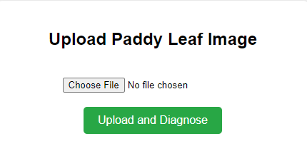
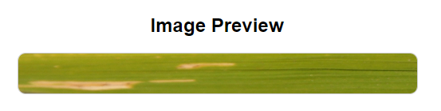
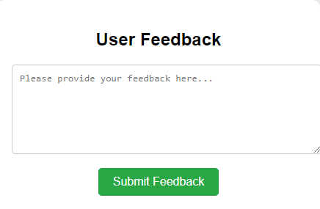
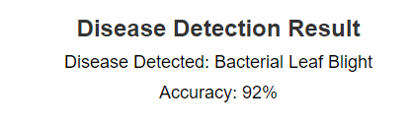
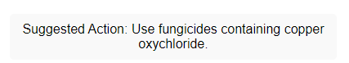
Wireframe designs
CSE21365

Slide 50
Explanation of wireframe designs:
CSE21365
Image Upload Module: Allows users to upload paddy leaf images for disease detection via a form. It also provides a preview of the uploaded image.
Image Preview Module: Displays a preview of the image chosen by the user, allowing them to verify it before submitting.
Disease Detection Module: Simulates the detection of paddy leaf diseases by using predefined disease types with accuracy scores, showing the result to the user.

Slide 51
Result Display Module: Shows the detected disease and the corresponding accuracy score once the image has been analyzed.
Suggested Action Module: Provides recommended actions based on the detected disease. For example, it suggests appropriate treatments such as the use of pesticides or preventive agricultural practices to manage the disease.
User Feedback Module: Allows users to provide feedback on the detection result and the suggested action. Users can rate the accuracy of the detection and give comments, helping improve the model's effectiveness.

Slide 52
Working of the product
CSE21365
Step 1: User Interaction with the System
Image Upload:
The user accesses the platform and is greeted with an interface to upload an image of a paddy leaf.
They select an image from their device by clicking on the "Upload and Diagnose" button.
Preprocessing of Image:
Once the image is uploaded, the AI model preprocesses the image. This might involve steps like:
Resizing the image to a fixed dimension suitable for the model.
Filtering to remove noise or enhance key features, such as leaf texture or color changes.
Step 2: AI-based Disease Detection
Image Analysis using Computer Vision:
The preprocessed image is fed into a deep learning model trained specifically for detecting paddy leaf diseases.
The model analyzes the image to detect patterns, color variations, and texture anomalies using a Convolutional Neural Network (CNN).

Slide 53
4.Disease Classification:
The AI model has been trained on a dataset of paddy leaf images, labeled with specific diseases. The model predicts the most likely disease from categories such as:
Bacterial leaf blight
bacterial leaf treak
bacterial panicle blight
blast
brown spot
dead heart
downy mildew
Hispa
normal
Rice sheath blight
smut
tungro

Slide 54
5. Diagnosis Display:
The system presents the user with the following information:
Disease Name (e.g., "Bacterial Leaf Blight").
Confidence Score (e.g., "92% confidence").
Suggested Action (e.g., "Use fungicides containing copper Oxychloride").
Step 3: Displaying Results to the User
These results are displayed in a clean, organized manner on the screen.
Step 4: User Feedback and Continuous Learning
For each prediction, the model outputs a confidence score, indicating how sure it is about the diagnosis (e.g., "92% confident").

Slide 55
User Feedback Collection:
After the results are displayed, the system encourages users to provide feedback regarding the accuracy of the diagnosis or general user experience.
The feedback is gathered via a form where users can type in their comments and submit them.
AI Continuous Learning:
The feedback provided by users can be used to improve the model. For instance:
If a user reports that the diagnosis was incorrect, the feedback could be reviewed, and the system could use this information to retrain or fine-tune the model.
Over time, this creates a continuous learning loop where the AI becomes more accurate as more users interact with the system.
Step 5: Actions for Disease Management
Allowing users to track their paddy field’s health over time by uploading multiple images and viewing a timeline of results.

Slide 56
Actionable Insights:
Based on the disease detected, the system provides recommended treatment options or actions the user should take to mitigate the disease. This might include:
Suggesting fungicides or insecticides.
Recommending specific agronomic practices to prevent the disease from spreading.
Step 6: AI Model Backend Enhancements
Backend Processing and Model Update:
The AI model operates in the backend, continuously learning from new image uploads and user feedback.
It leverages Transfer Learning from existing image classification models and retrains periodically using new data, ensuring the disease detection capability remains up-to-date with evolving patterns and potential new diseases.
Step 7: User Follow-up
Monitoring and Follow-up:
The system could offer follow-up options such as:
Notifications to re-upload a leaf image after a treatment period to check for improvements.

